Slide 1







MARELLA MISSION

Slide 2
HILLS YARNING ACKNOWLEDGES THAT WE WALK UPON THE TRADITIONAL LANDS OF FIRST NATIONS PEOPLES. WE PAY OUR RESPECTS TO THEM AND RECOGNISE THE CONTINUING GIFT OF THEIR CULTURES TO THE LIFE AND SPIRIT OF AUSTRALIA.

Slide 3
ABORIGINAL AND TORRES STRAIT ISLANDER PEOPLE SHOULD BE AWARE THAT THIS PRESENTATION MAY CONTAIN IMAGES, VOICES AND NAMES OF DECEASED PERSONS.

Slide 4
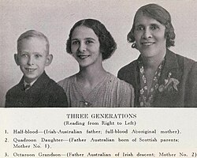
ASSIMILATION
  Assimilation policies were founded in the highly racialised idea that First Nations Peoples and cultures were inferior to those of White Australians
  The assimilation policy aimed to eradicate First Nations culture through forcibly disconnecting First Nations children from their families and communities and ‘re-educating’ them in white run institutions and missions.
A.O. NEVILLE - 1947 BOOK “AUSTRALIA'S COLOURED MINORITY - ASSIMILATION POLICY” HTTPS://COLLECTIONS.MUSEUMSVICTORIA.COM.AU/ITEMS/1496210

Slide 5
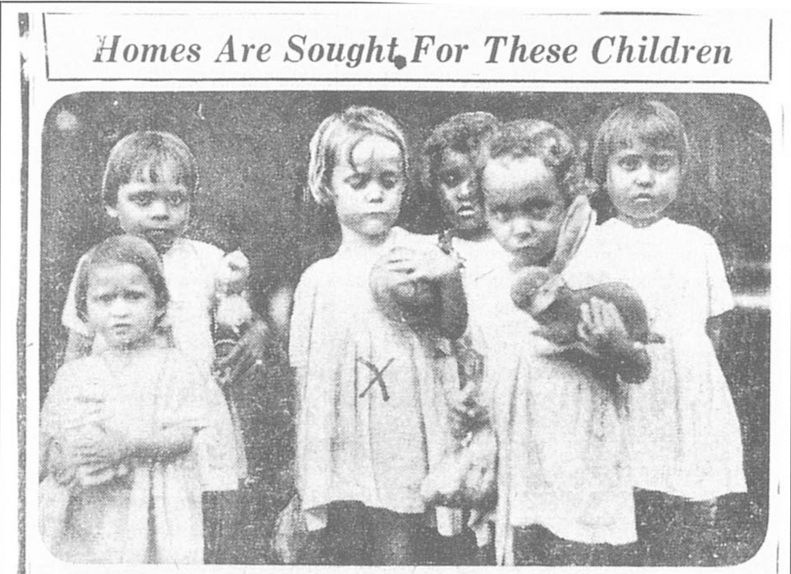
STOLEN GENERATIONS
  The forcible removal of First Nations children from their families is known as the Stolen Generations and was undertaken as part of broader government policies such as assimilation.
  In 1883 The NSW “Board for the Protection of Aborigines” was established. The 1909 ‘Aborigines Protection Act’ granted them power to remove First Nations children from their families without court approval. This was succeeded by the “Aborigines Welfare Board”
NEWSPAPER ARTICLE, NATIONAL ARCHIVES OF AUSTRALIA
THE 1997 BRINGING THEM HOME REPORT estimates that between 1/3 to 1/10 First Nations children were taken from their families between 1910 and 1970.

Slide 6
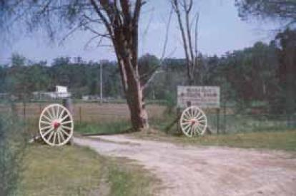
WHAT WAS MARELLA MISSION
  Ran by Keith and Gwen Langford Smith, Marella Mission, located in Kellyville, purported to “foster Aboriginal children born in New South Wales to mothers who had been evacuated from the Northern Territory during World War II” .
  However in reality, from around 1953 until 1986, Marella Mission Farm was an institution where stolen First Nations children were removed to.

Slide 7
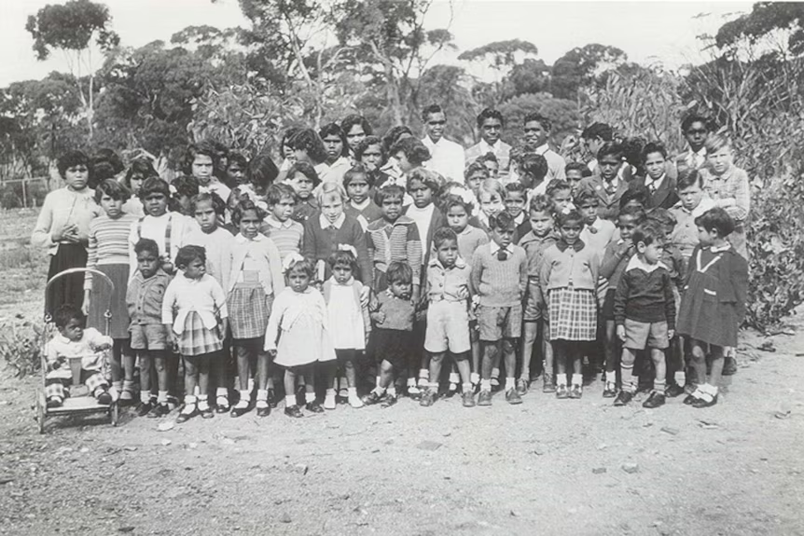
WHY WAS MARELLA MISSION ESTABLISHED
  Institutions such as Marella Mission, prevented children from connecting to their culture, Country, community and family.
  Children were taught skills such as housekeeping and farmhandling for future service in white households. They were denied the same education as local white children
  Former resident and survivor of Marella Mission, Aunty Rita Wright, recounts being treated “like slaves”.
THE CHILDREN OF THE CHURCHES OF CHRIST MISSION IN NORSEMAN WA. (1960S)

Slide 8
ABORIGINES WELFARE BOARD AND MARELLA
Investigations by the NSW Stolen Generations Reparations Scheme found that:
“[Aborigines Welfare] Board records show that when the Child Welfare Department raised concerns in the 1950s that Marella was not complying with provisions of the Child Welfare Act 1939... the Board successfully rebuffed the department’s attempts to introduce inspections. … it is evident that the placement of many Aboriginal children at Marella occurred with the knowledge and awareness of the Board (Interim Report, p. 31).”
(Find & Connect, 2025)

Slide 9

AUNTY RITA
Listen as Aunty Rita discusses her first hand experiences at Marella Mission as a victim of the Stolen generations.

Slide 10
LIFE AT MARELLA MISSION
Jasmine Franklin, a survivor of Marella Mission, stated:
“All our foods were basic. We had porridge full of weevils every morning and old fruit, stale biscuits or cakes that were donated. We were always hungry, eating berries and other bush tucker we could find, and we became very resourceful.”
(Find & Connect, 2025)
  Life at Marella Mission was extremely difficult
  Children were forced to do hard labour and farmwork.
  Children lived in generally poor conditions, with limited food, clothing and shelter.
  They were forced to refer to Keith and Gwen as ‘Mum’ and ‘Dad’ .
  Children faced harsh punishments for ‘misbhehaving’

Slide 11
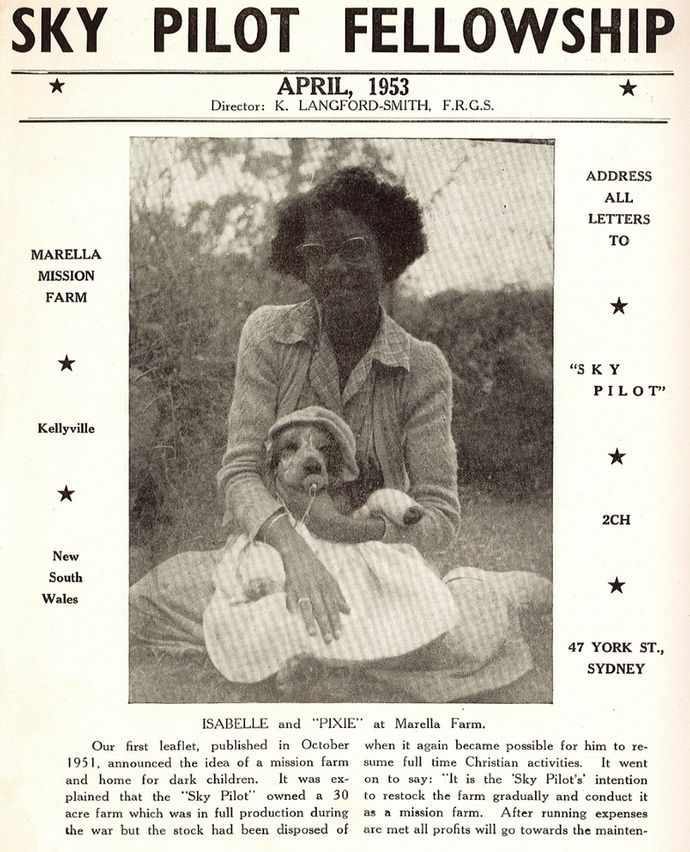
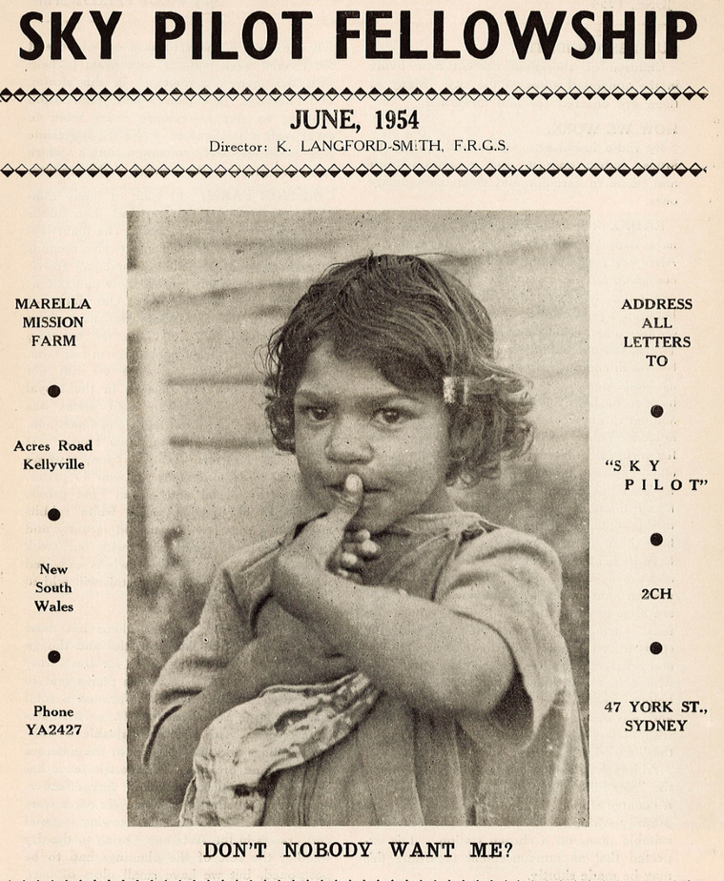
SKY PILOT FELLOWSHIP
  Keith Langford Smith became somewhat famous for his radio broadcasts, recounting his flying experiences over Arnhem Land.
  He created the ‘Sky Pilot Fellowship’ radio broadcast and newsletter primarily to gather public donations to keep Marella Mission running.

Slide 12
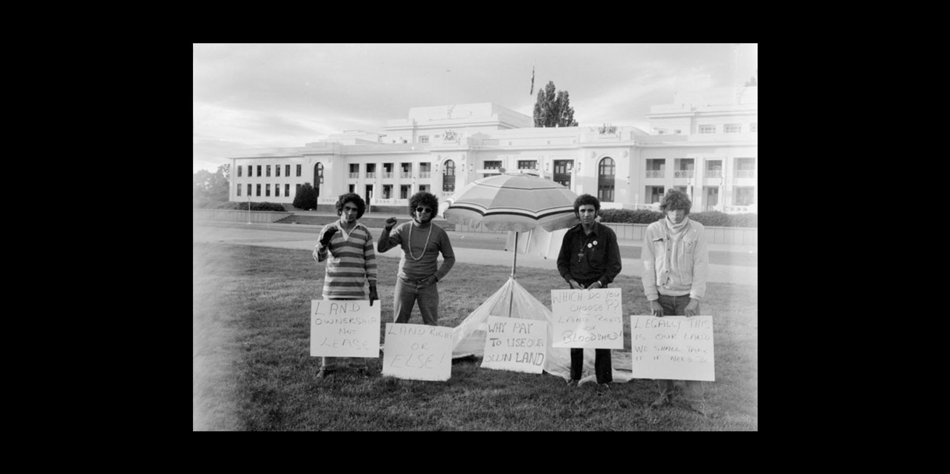
1970S
  The 1970s marked a period of change, with the rights of First Nations Peoples making some progress
  The 1972 Tent embassy (pictured on the right) was created as a form of protest. They demanded the preservation of sacred sites, ownership and mining rights to traditional lands and compensation for those that could not be returned.
  The 1976 Aboriginal Land Rights (Northern Territory) Act was passed, allowing First Nations Peoples to claim land rights based on traditional ownership

Slide 13
MARELLA MISSION CLOSURE
Self-Determination: is the desire of people to be able to make decisions about matters that affect their lives. Essential to the exercise of self-determination is choice, participation and control.
From the mid-1970s, the push for self-determination and sovereignty intensified.
In 1976, The Sky Pilot News reported that First Nations activists “wanted to close Marella”
By 1978, the children were transferred to other missions and local ‘homes’. Marella Mission Farm Ltd was formed so that the land could be donated.
Sovereignty: the right of Indigenous peoples to self-determination, governance, and control over their lands, cultures, and futures. Sovereignty is based on the fact that First Nations existed as distinct nations with laws and institutions prior to colonisation.

Slide 14
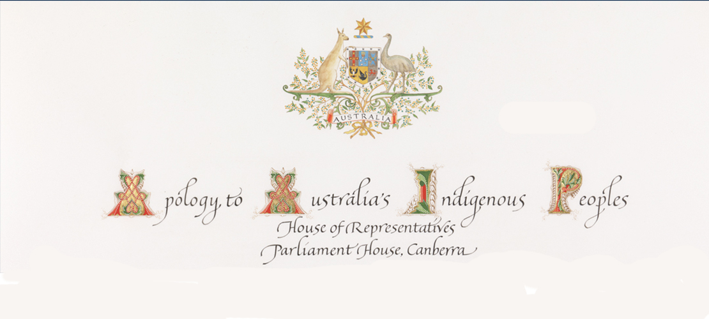
KEVIN RUDD APOLOGY
“FOR THE PAIN, SUFFERING AND HURT OF THESE STOLEN GENERATIONS, THEIR DESCENDANTS AND THEIR FAMILIES LEFT BEHIND, WE SAY SORRY”
  The 1997 ‘Bringing Them Home’ report documented the intergenerational impact caused by the policies, laws and procedures of the Australian Government and the resulting Stolen Generations.
  One of its key recommendations was an acknowledgement and apology for the forcible removal of First Nations children.
  On February 13, 2008, former Prime Minister Kevin Rudd, issued a formal apology to the Stolen Generations

Slide 16
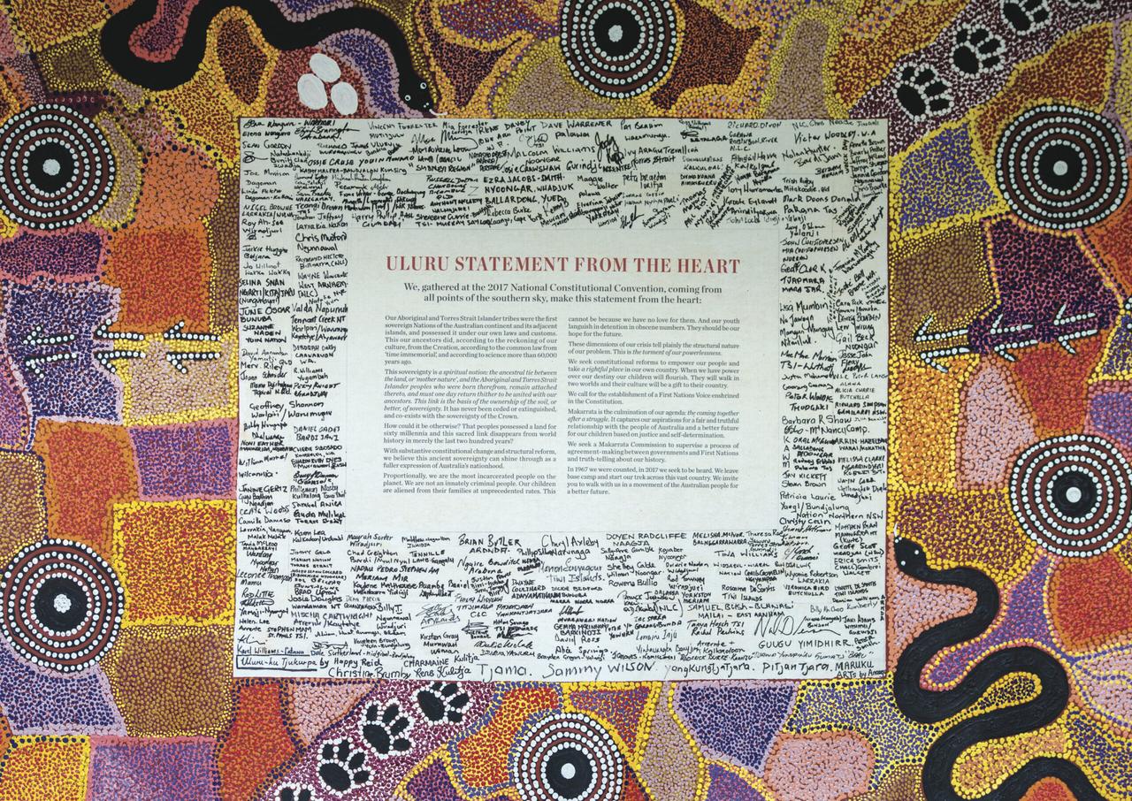
ULURU STATEMENT FROM THE HEART
“IN 1967 WE WERE COUNTED, IN 2017 WE SEEK TO BE HEARD.”
  The Uluru Statement from the heart (2017) called for the establishment of a First Nations Voice in the Constitution.
  “Makarrata is the culmination of our agenda: the coming together after a struggle. It captures our aspirations for a fair and truthful relationship with the people of Australia and a better future for our children based on justice and self-determination.”
(Referendum Council, 2017)

Slide 17
ULURU STATEMENT FROM THE HEART

Slide 18
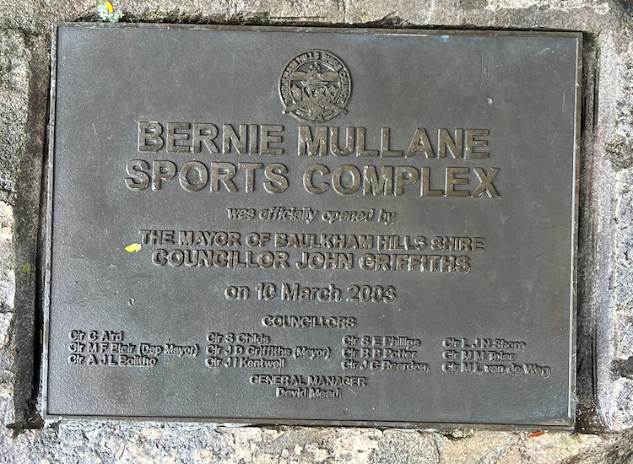
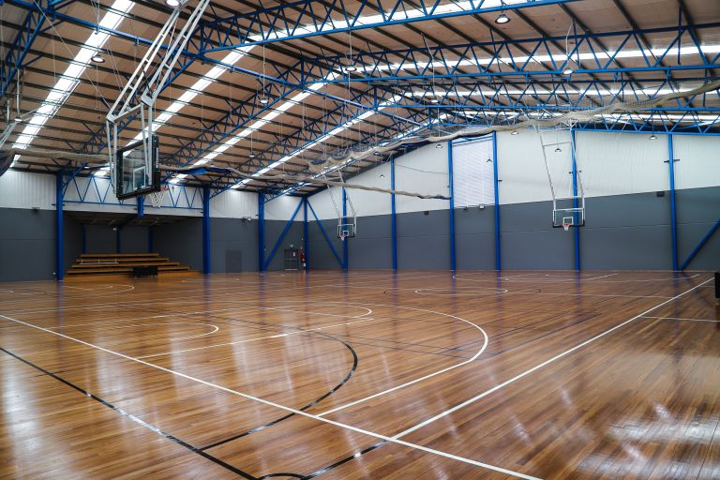
TODAY
  If you go to the land that once housed Marella Mission today, you will find Bernie Mullane Sports Complex.
  At the entrance there is a prominent plaque commemorating the late local councillor Bernie Mullane. Off to the side and easily missed, is a small information sign about Marella.
Did you know?
Up until 2023, the road that housed Marella Mission was named “Langford Smith Close” after Keith and Gwen Langford Smith, the owners and operators of Marella Mission.

Slide 19
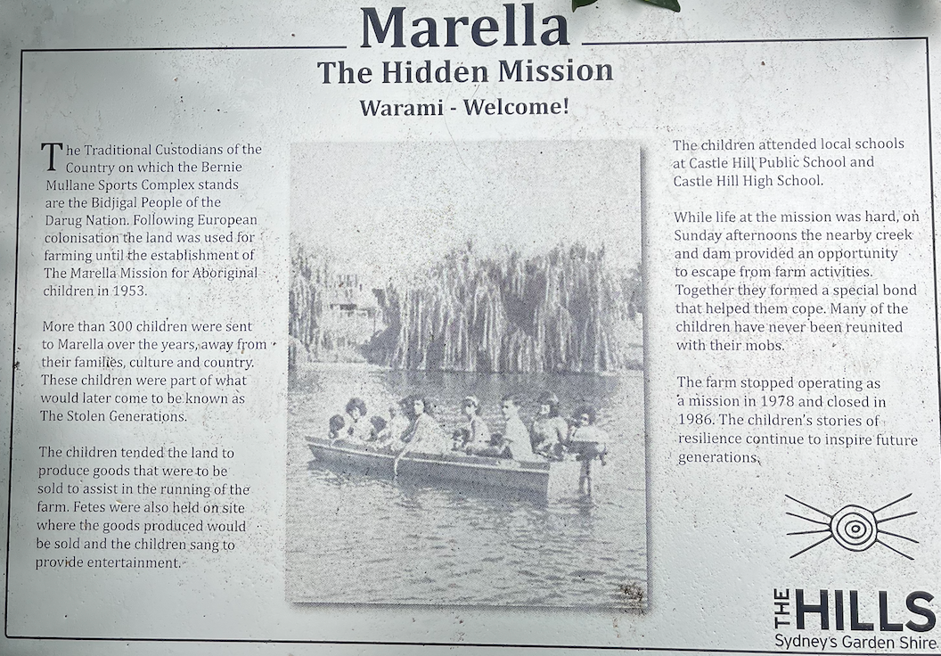

Slide 20
The sign reads:
The Traditional Custodians of the Country on which Bernie Mullane Sporting Complex stands are the Bidjigal People of the Darug Nation. Following European colonisation the land was used for farming until the establishement of Marella Mission for Aboriginal Children in 1953.
More the 300 children were sent to Marella over the years, away from their family, culture and country. These children were part of what would later be known as the Stolen Generations.
The children tended the land to produce goods that were sold to assist in the running of the farm. Fetes were also held on site, where to goods produced would be sold and the children sang to provide entertainment.
The children attended local schools at Castle Hill Public School and Castle Hill High School.
When life at the mission was hard, on Sunday afternoons, the nearby creek and dam provided an opportunity to escape from farm activities. Together, they formed a special bond that helped them cope. Many children have never been reunited with their mobs.
The farm stopped operating as a mission in 1978 and closed in 1986. The childrens stories of resilience continue to inspire future generations.

Slide 22
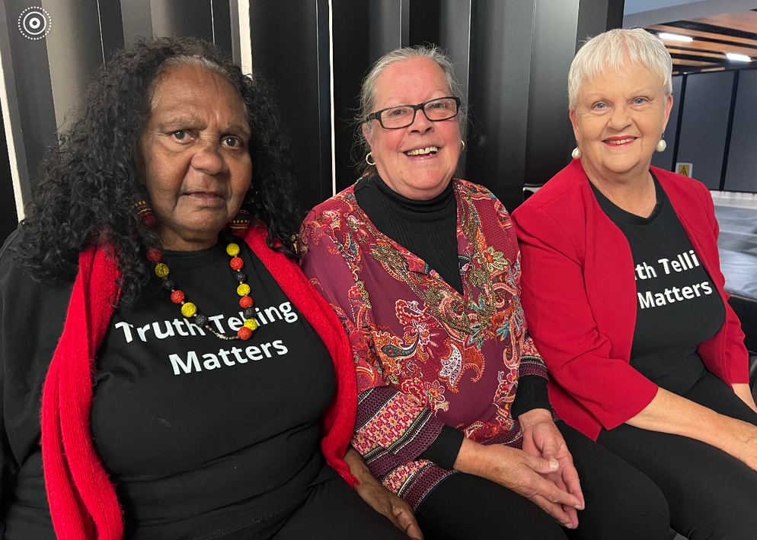
RENAMING THE ROAD
  Aunty Rita Wright and Jan Wright spent years petitioning to change the name of the road.
  When contacted by Hills Shire Council, a majority of residents supported changing the name.
Resident Sheryn Carusi spoke on behalf of the community at the council meeting to change the name, stating:
“We are proud to live in the Hills, but not proud to continue to honour Keith Langford Smith... The past can’t be undone but by acknowledging what happened and removing any honour connected to him, we can give those who still live with the memories a chance to heal and know we are a community who really cares.”
FROM LEFT TO RIGHT: AUNTY RITA WRIGHT (NEE LEE), SHERYN CARUSI AND JAN WRIGHT

Slide 23
RENAMING THE ROAD
  In 2023, Councillor Mila Kasby moved the motion to approve the name change.
  The street is now officially named “Nimbus Close”
  Aunty Rita said she was “over the moon” with the result. “Now I will be able to sleep,” she said.
FROM LEFT TO RIGHT: AUNTY RITA WRIGHT (NEE LEE), SHERYN CARUSI AND JAN WRIGHT

Slide 24
LEGACY
Marella Mission serves as a reminder of the importance of being aware of the history within our own backyards.
Although there is still much work to be done to adress the wrongs of the past, the name change acts as a testament to the power of walking with and alongside eachother.

Slide 25
QUIZLET
https://quizlet.com/au/1140710141/marella-mission-flash-cards/?i=70ywdq&x=1jqt

Slide 26
SOURCES
ABC News (Australia). (2018). Apology to Australia’s Indigenous Peoples (2008). In YouTube. https://www.youtube.com/watch?v=RThkO3XBThs
AIATSIS. (n.d.). MS 5239 Marella Mission Farm . Retrieved February 7, 2026, from https://aiatsis.gov.au/sites/default/files/catalogue_resources/MS5239_Marella%20Mission%20Farm.pdf
Find & Connect. (2025). Marella Mission Farm. Find and Connect. https://www.findandconnect.gov.au/entity/marella-mission-farm/
Gal, D. (2016). An individual’s memories of the Stolen Generation. In YouTube. https://www.youtube.com/watch?v=EMuS2VltLTs
Jordan, B. (2023). Aunty Rita Applauds Name Change. Hills to Hawkesbury Community News; Hills to Hawkesbury News. https://hillstohawkesbury.com.au/aunty-rita-applauds-name-change/
Moore Theological College. (2026). Sky Pilot News. Jstor.org. https://www.jstor.org/site/moore-theological/sky-pilot-news/?so=item_title_str_asc
O’Loughlin, M. (2020). The Stolen Generation. The Australian Museum. https://australian.museum/learn/first-nations/stolen-generation/?gad_source=1&gad_campaignid=10182822197&gbraid=0AAAAADj48YmbHIvyUg0zorQgw7zP0vRNr&gclid=Cj0KCQiAm9fLBhCQARIsAJoNOcvXpwaSdbSlJWothhbpq9734KwHjNxjmBjAyT2RUm_NhJjCjUJR_nEaAnEsEALw_wcB
Parliament of Australia. (2008). Apology to Australia’s Indigenous Peoples. Parliament of Australia. https://www.aph.gov.au/Visit_Parliament/Art/Icons/Apology_to_Australias_Indigenous_Peoples
Referendum Council. (2017). Uluru statement from the heart. The Uluru Statement. https://ulurustatement.org/the-statement/view-the-statement/
Shoebridge, D. (2020). Marella Mission. Facebook.com. https://www.facebook.com/watch/?v=686119455666425
The Hills Shire Council. (2026). The stories behind the headstones. Nsw.gov.au. https://www.thehills.nsw.gov.au/Residents/Library/Local-Studies-Family-History/History-of-Local-Cemeteries/Castle-Hill-Cemetery-History-and-Headstones/The-stories-behind-the-headstones
Wright, A. (2015). Marella: Out Of Hiding. https://img1.wsimg.com/blobby/go/27596b8e-b624-428b-9eb2-d8dd7109dbf6/downloads/Marella%20-%20Out%20of%20Hiding.pdf

